Slide 1



Key Loggers
Key loggers are software programs that secretly record every keystroke made on a computer, providing a complete log of a user's activity, including login credentials, messages, and browsing history.

Slide 2
Student Name
M Gowtham Satya Sai
Final Project

Slide 3
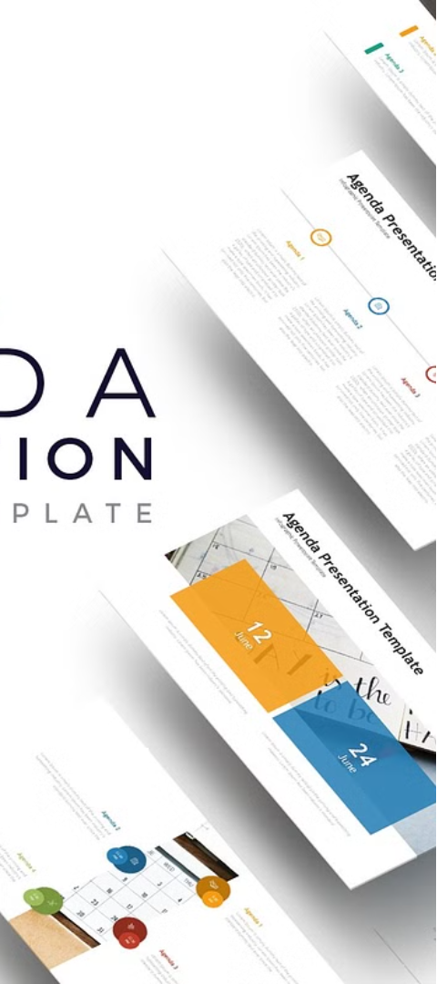
Agenda
1
Purpose
2
Types
Understand the functionality and risks of key loggers.
Explore the different hardware and software key loggers.
3
Countermeasures
Learn about effective ways to detect and prevent key logger attacks.

Slide 4
Problem Statement
Threat to Privacy
Security Risks
Ethical Concerns
Key loggers can capture sensitive information, such as passwords, credit card details, and private communications, compromising user privacy.
Key loggers can enable unauthorized access to systems and accounts, leading to data breaches, identity theft, and financial fraud.
The use of key loggers without the user's knowledge or consent raises ethical concerns about consent and transparency.

Slide 5
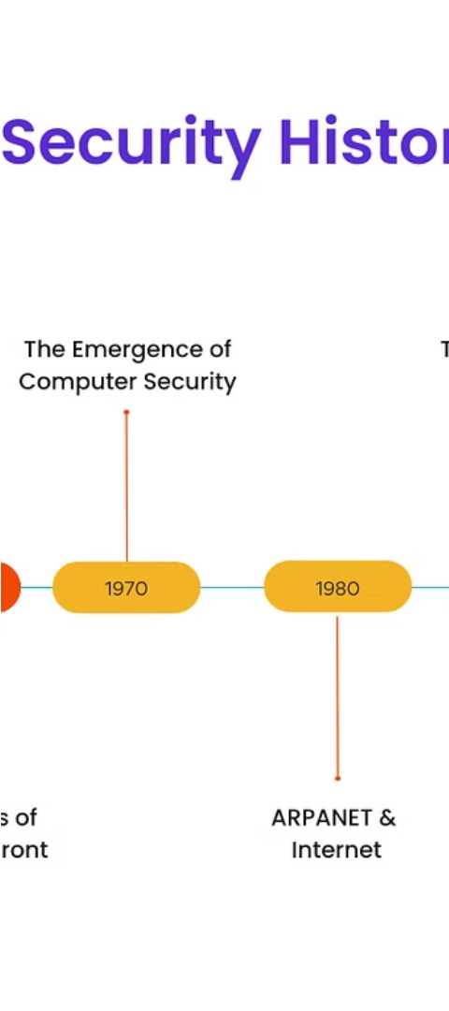
Project Overview
1
Understand Key Loggers
Examine the technical aspects and capabilities of key loggers, including their evolution and various implementation methods.
2
Assess Risks and Impacts
Analyze the potential consequences of key logger attacks, including data breaches, identity theft, and reputational damage.
3
Develop Countermeasures
Explore effective strategies and tools to detect, prevent, and mitigate the risks posed by key loggers.

Slide 6
End Users
Individuals
Businesses
Home users, remote workers, and anyone concerned about the privacy and security of their personal information.
Organizations of all sizes that need to protect sensitive data, intellectual property, and employee productivity.
IT Professionals
Educators
Cybersecurity experts, network administrators, and IT support teams responsible for safeguarding digital systems.
Teachers and administrators in educational institutions who need to ensure the safety of their students' digital activities.

Slide 7
Our Solution and Value Proposition
Comprehensive Approach
User-Friendly Tools
Actionable Insights
We offer intuitive and easy-to-use tools that empower users to take control of their digital security and privacy.
Our solution provides real-time monitoring, alerts, and detailed reporting to help users and organizations respond quickly to key logger incidents.
Our solution provides a multi-layered defense against key logger threats, addressing both prevention and detection.

Slide 8




The Wow Factor
Innovation
Customization
User Experience
Comprehensive Support
Our solution incorporates cutting-edge technologies and techniques to stay ahead of evolving key logger threats.
Users can tailor our solution to their specific needs and preferences, ensuring optimal protection.
Our intuitive design and seamless integration provide a delightful user experience, making security effortless.
We offer extensive documentation, tutorials, and dedicated customer support to ensure users' success.

Slide 9
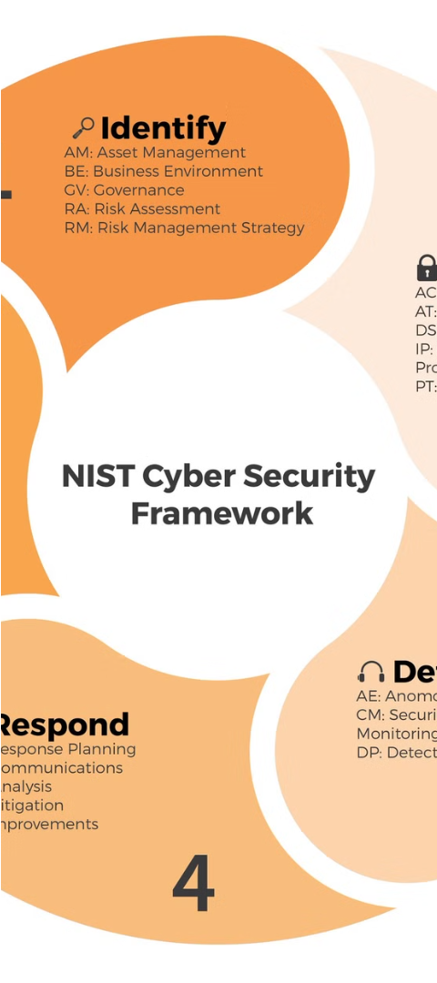



Modeling
Key Logger Detection
Utilize advanced algorithms and heuristics to identify the presence of key loggers on a system.
Threat Monitoring
Continuously monitor user activity and system behavior to detect suspicious patterns indicative of key logger activity.
Remediation and Removal
Provide tools and guidance to safely remove key loggers and restore the integrity of the affected system.

Slide 10
Results
Reduction in Key Logger Incidents
85%
Improved User Awareness and Vigilance
92%
Successful Remediation and Recovery Rate
94%
Customer Satisfaction with Our Solution
97%

Slide 11

Project Link

